Slide 1
Triage tool for OR planning during the COVID-19 pandemic (and beyond?)
Benjamin Gravesteijn
Eline Krijkamp
June, 2020
Notes:
A full report of the model is available with more details

Slide 2
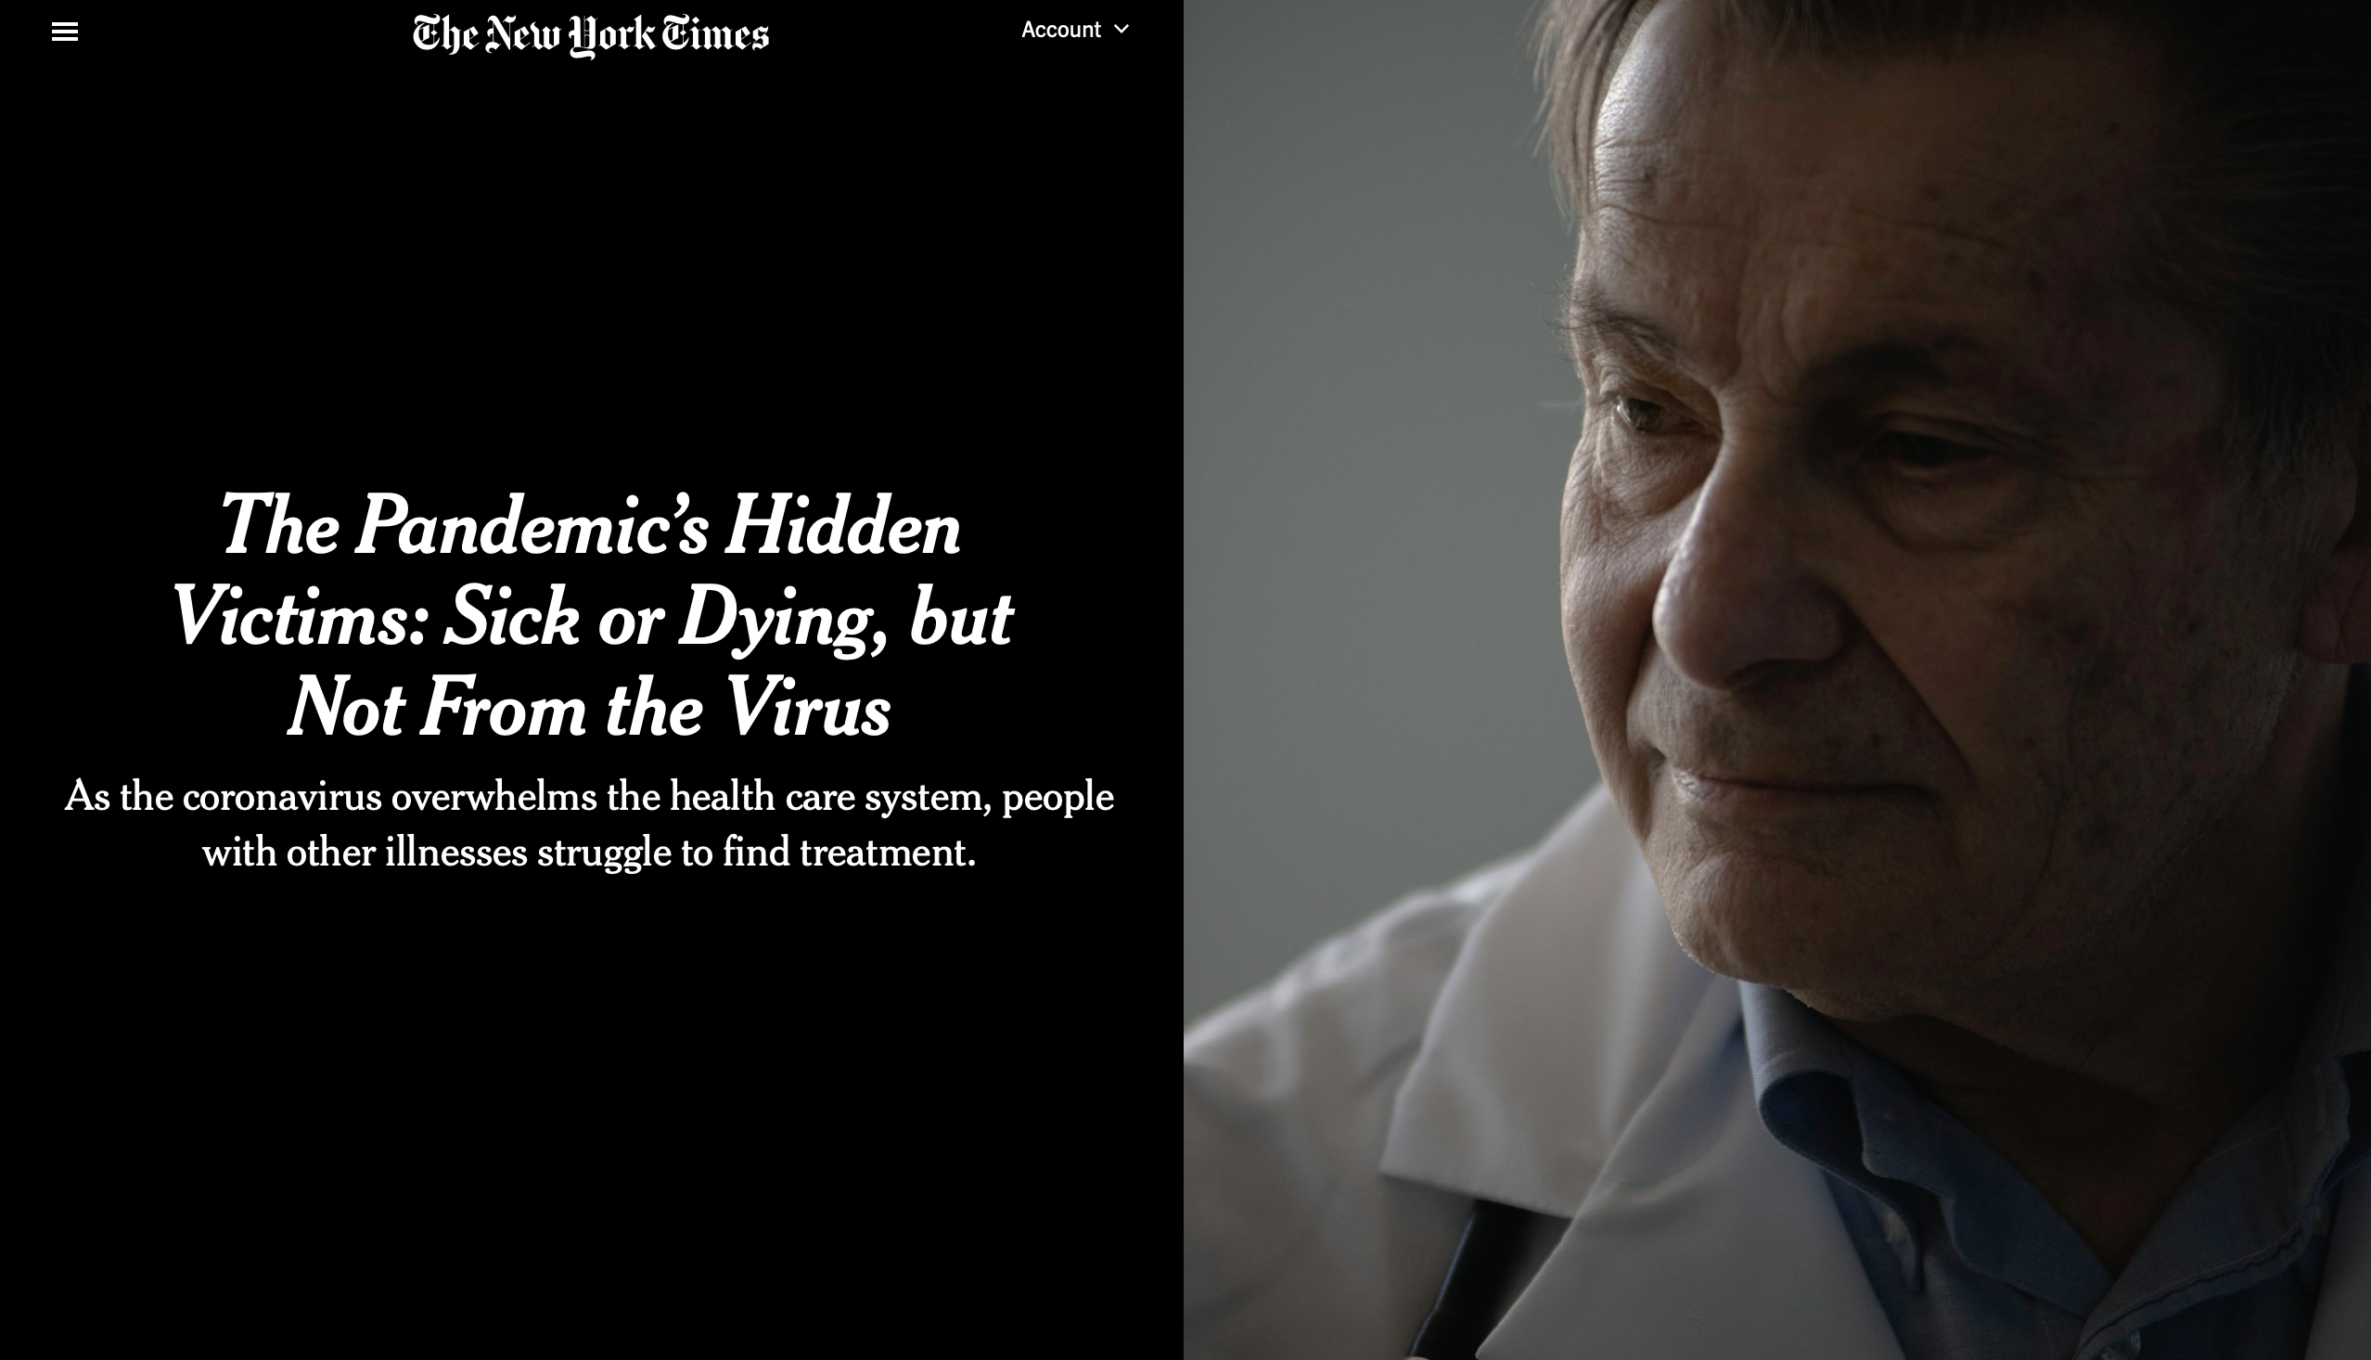
Notes:
https://www.nytimes.com/2020/04/20/health/treatment-delays-coronavirus.html

Slide 3

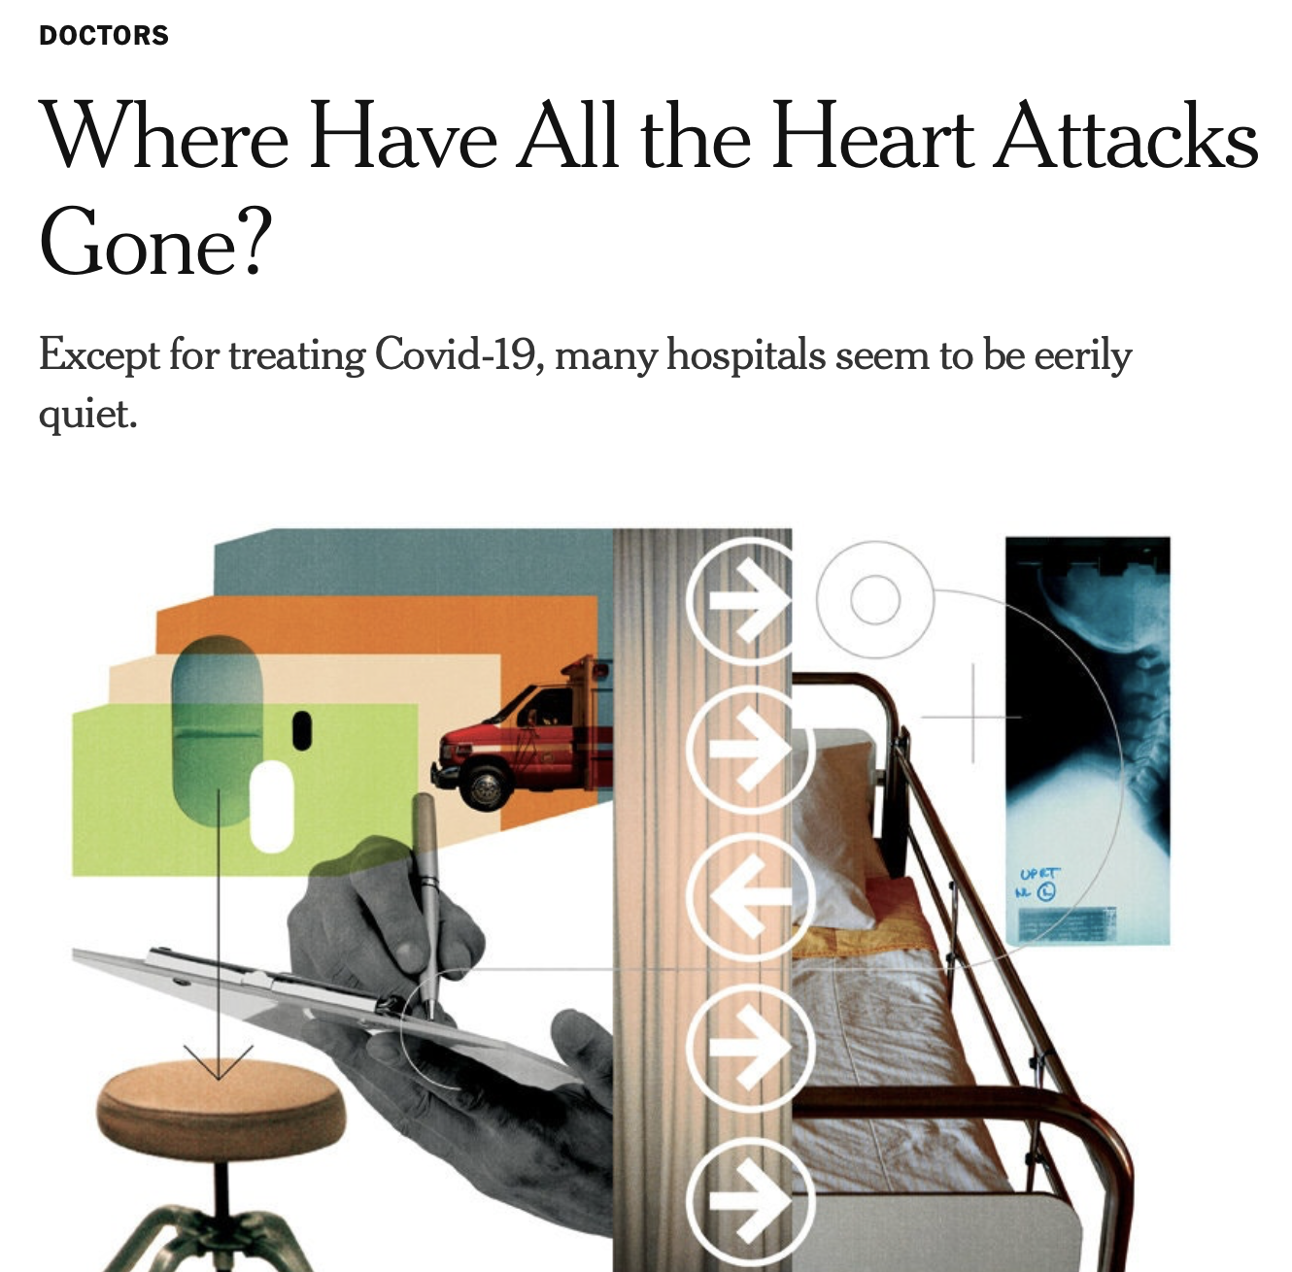

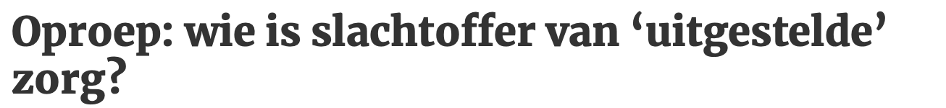
The problem: COVID-19 outcompetes regular care
Notes:
https://www.limburger.nl/cnt/dmf20200331_00154248/oproep-wie-is-slachtoffer-van-uitgestelde-zorg
https://www.nytimes.com/2020/04/06/well/live/coronavirus-doctors-hospitals-emergency-care-heart-attack-stroke.html

Slide 4
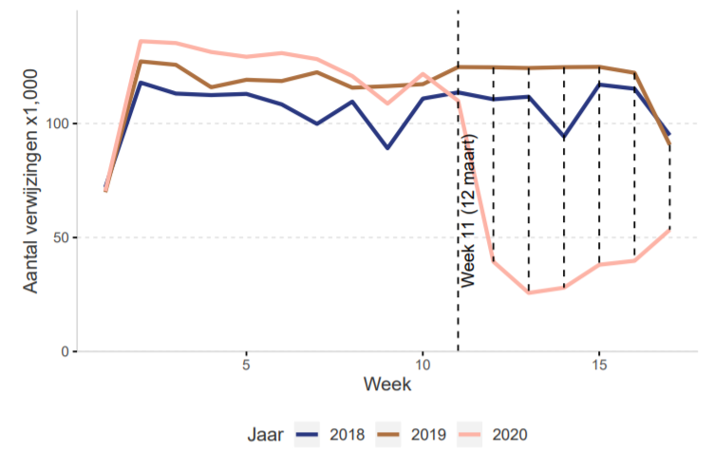
Stuwmeer (NZA)
Notes:
Uit een recente inventarisatie van de Nederlandse Zorgautoriteit blijkt dat sinds begin maart 290.000 geplande behandelafspraken in de ziekenhuizen niet zijn doorgegaan. In het Erasmus MC gaat het om zo’n 5000 operaties, wat neerkomt op 11.000 uur opereren. Als de twintig operatiekamers die sinds kort weer open zijn (het Erasmus MC telt er in totaal 26), elke dag acht uur operationeel zijn, zou de achterstand in 69 dagen zijn weggewerkt. “Maar dat is verre van realistisch,” zegt Baatenburg de Jong.

Slide 5
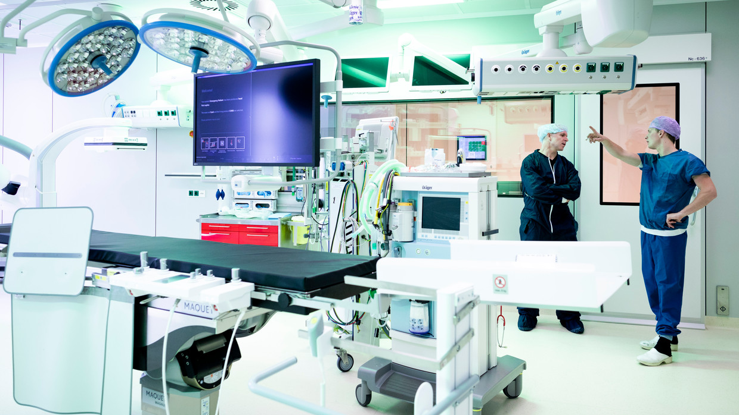
“Just 5 OR for non-emergency care in EMC”

Slide 6

How are we optimizing the use of operation rooms?
Or how are we minimizing the consequences of delayed care?

Slide 7
Ethical perspective
Maximize the benefits produced by scare resources
Treat people equally
Promote and reward instrumental values
Give priority to the worst-off (the sickest or youngest.
In the context of a pandemic, maximizing the benefits is justifiable.
This is a utilitarian ethical perspective: Which holds that the most ethical choice is the one that will produce the greatest good for the greatest number.
Emanuel EJ et al. N Engl J Med 2020;1–7. Vergano M, et al. SIAART 2020
Notes:
Experts in the field of medical ethics recently proposed that the distribution of scarce (surgical) resources can be evaluated by the following four ethical values: 1) Scarce resources are used to maximize the benefits; 2) People are treated equally; 3) Instrumental value is promoted and rewarded; 4) People that are worst off (e.g., the sickest or youngest) are prioritized.² In the context of a pandemic, it is justifiable to focus on maximizing benefits (ethical value 1).^{12–16} This is consistent with utilitarian ethical perspectives, which emphasize total population outcomes over individual outcomes when resources are scarce.¹⁷
Text from the paper from Emanuel
Each of these four values can be operationalized in various ways (Table 2). Maximization of benefits can be understood as saving the most individual lives or as saving the most life-years by giving priority to patients likely to survive longest after treatment. Treating people equally could be attempted by random selection, such as a lottery, or by a first-come, first-served allocation. Instrumental value could be promoted by giving priority to those who can save others, or rewarded by giving priority to those who have saved others in the past. And priority to the worst off could be understood as giving priority either to the sickest or to younger people who will have lived the shortest lives if they die untreaed.
Hence, fair allocation requires a multivalue ethical frame- work that can be adapted, depending on the re- source and context in question. In the xont
https://plato.stanford.edu/entries/utilitarianism-history/

Slide 8
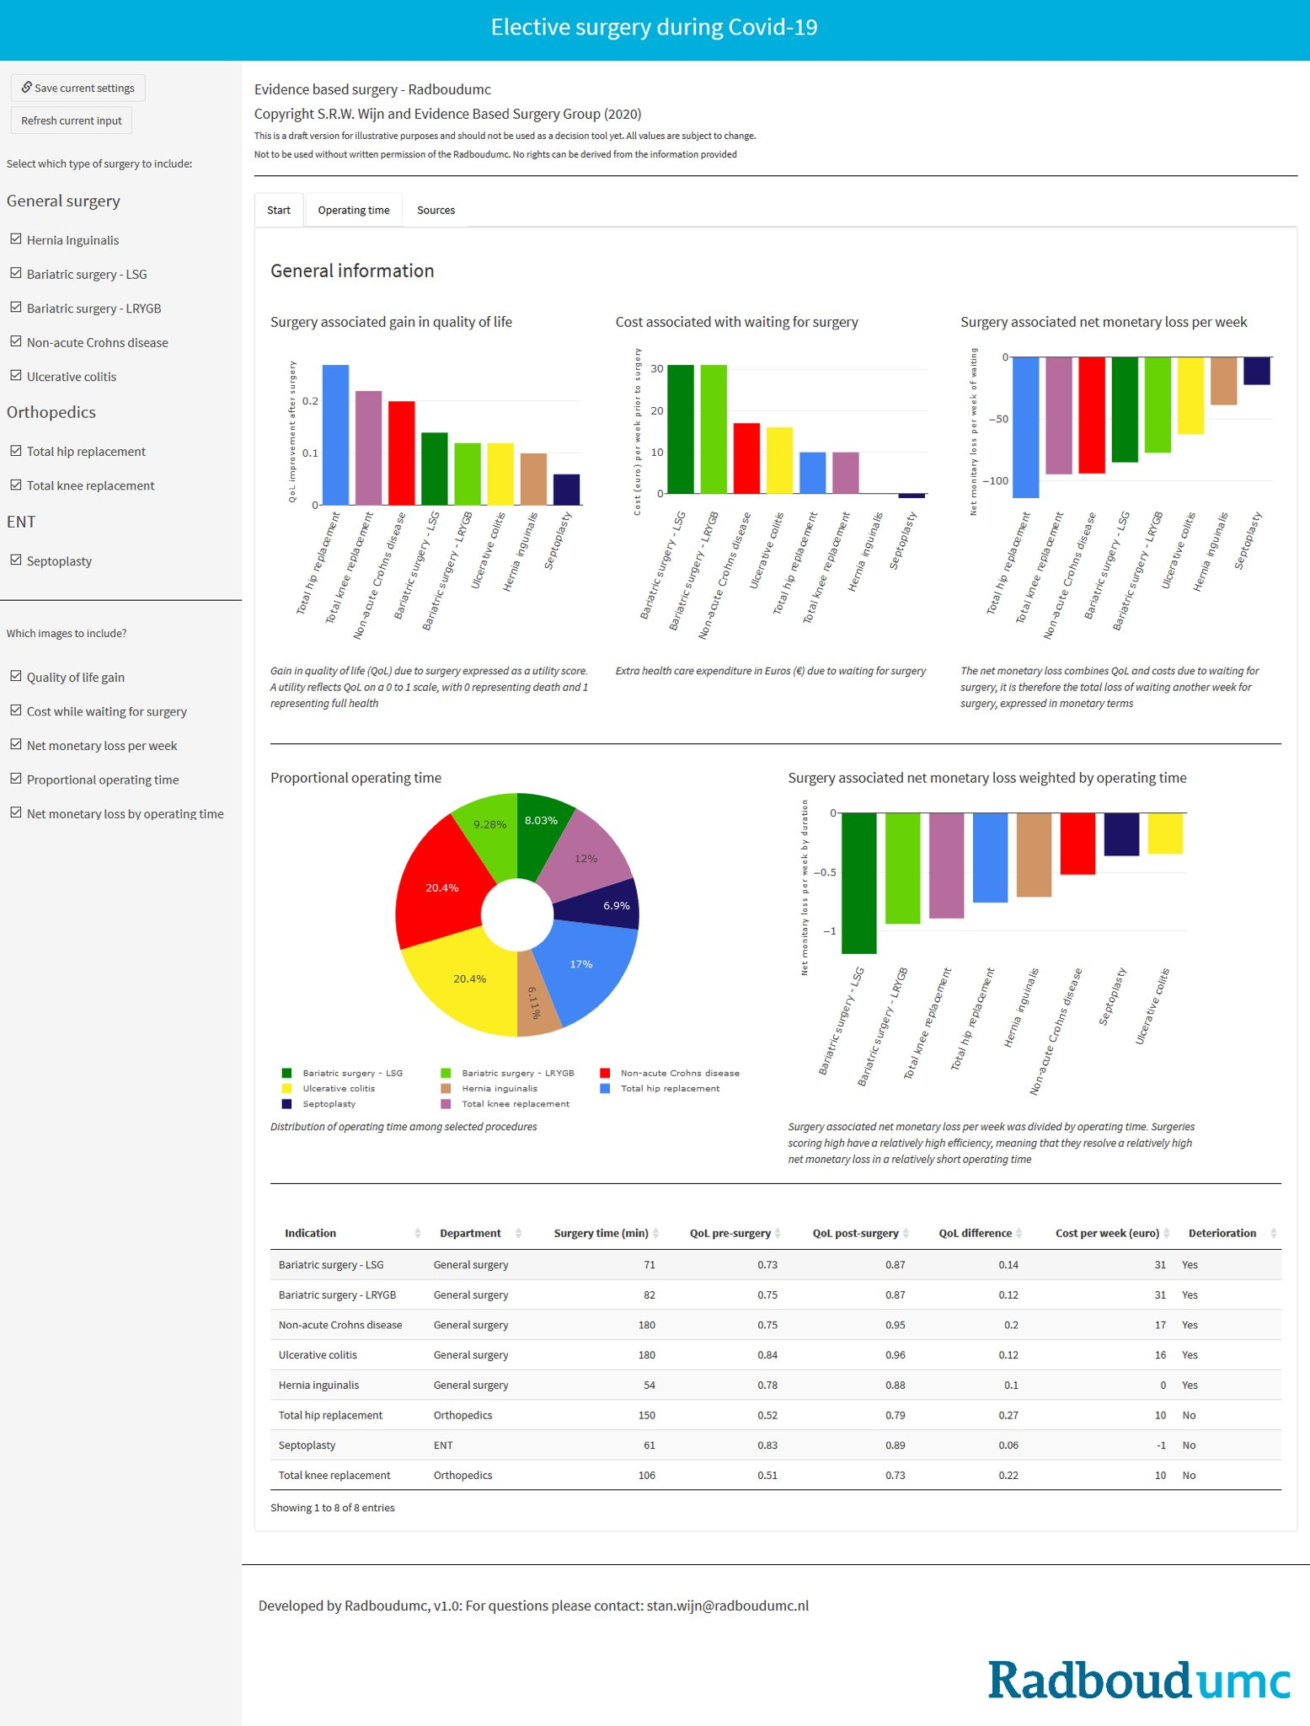
Radboud University
https://www.volkskrant.nl/wetenschap/wat-gaat-voor-een-nieuwe-knie-of-een-nieuwe-heup~b4beff52/ + twitter message researchers

Slide 9
By building a decision model that quantifies the consequences of delay
Focus on semi-elective care.
Care that can wait >72 hours, but in normal situation not longer than 3 weeks.
Population
All Erasmus MC patients with a semi-elective surgery indication
Surgeries
- Focus on the most frequently done surgeries
Notes:
We could add/tell the idea of “splitting time” per specialism and within they can decide themselves
The idea of those that scream loudest
Most ”urgent” ”severe” disease
We however, like to focus on within those surgeries/when are we losing the most ”health”

Slide 10
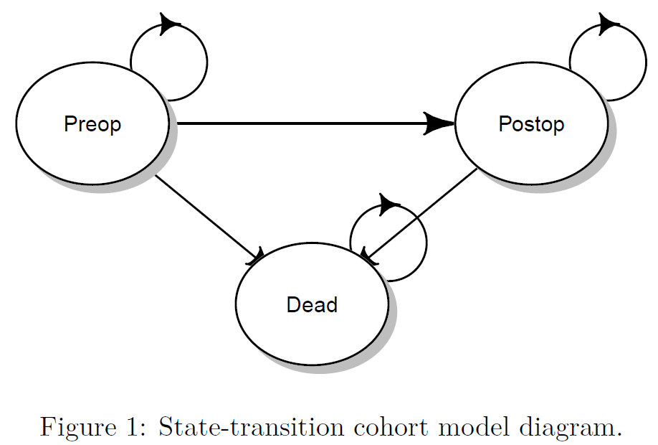
Model structure
Delay (2, 12, … 52 weeks)
Preop = preoperative
Postop = postoperative
Notes:
All patients that are eligible for surgery start in the Preoperative health state. There they are waiting to get surgery. The time of the surgery is defined by the parameter delay in the model. This model parameters models the weeks a patient has to wait to get surgery. While waiting for the surgery some patients might die and make the transition to dead. After the waiting time, the patients get surgery and make the transition to the post operation health state.
Several senarios for delay are modeled using 2, 12, 22 up to 52 weeks.

Slide 11
Model features
Delay
Time horizon: up to 100 years
Scenarios:
2, 12, 22, … 52 weeks delay
Infinite delay (“no surgery”)
Discount rate QALYs: 0.015
Output: QALYs
Probabilistic sensitivity analysis

Slide 12
Model parameters
Survival without treatment: survival of patients who are not operated on yet.
Survival with treatment: current survival, with maximal treatment
Treatment effect of operation: preferably evaluated in a RCT, RR/OR/HR. Operation vs do nothing/do something else.
QoL without treatment: utility of patients who did not yet have surgery
QoL with treatment: utility of patients who have had surgery
Average age of patient
Time to no effect of treatment on survival: e.g. in oncological surgery the time until the tumor becomes inoperable.
Time to no effect of treatment on QoL: e.g. in threatening retinal detachment the time until someone becomes irreversibly blind. Not applicable in interventions with a curative aim.
Found in the literature
Calculated, or found in the literature if treatment effect is not to be found
Collected via an expert panel meeting
Notes:
The model is informed by max. 8 parameters. The last two parameters are nog needed for all diseases

Slide 13

Interdisciplinary team work
Department of epidemiology
Department of public health
Team Value Based Health Care
Department of otorhinolaryngology (ENT)
Department of surgery
Source: VectorStock

Slide 14
Expert panel scored the utilities
Surgeons
Urology
Neurosurgery
Trauma
Oncology
Gynaecology
Otorhinolaryngology
Generalists
Reumatology
Geriatry
General practitioner

Slide 15
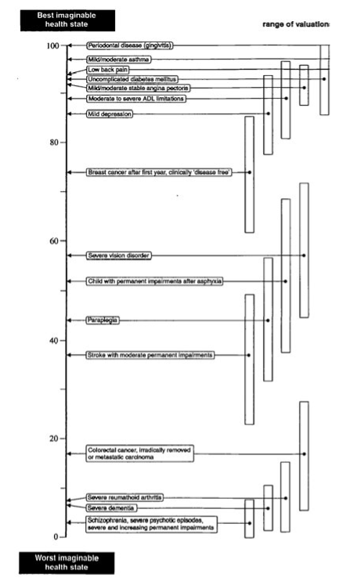
Expert panel scored the utilities
Top part of the calibrated vas

Slide 16
Survival data from registries
Dutch Cancer registry
Indication for operation vs no indication
Dutch cardiology registry
Post-intervention survival
Age
Not including gynaecological oncology

Slide 17
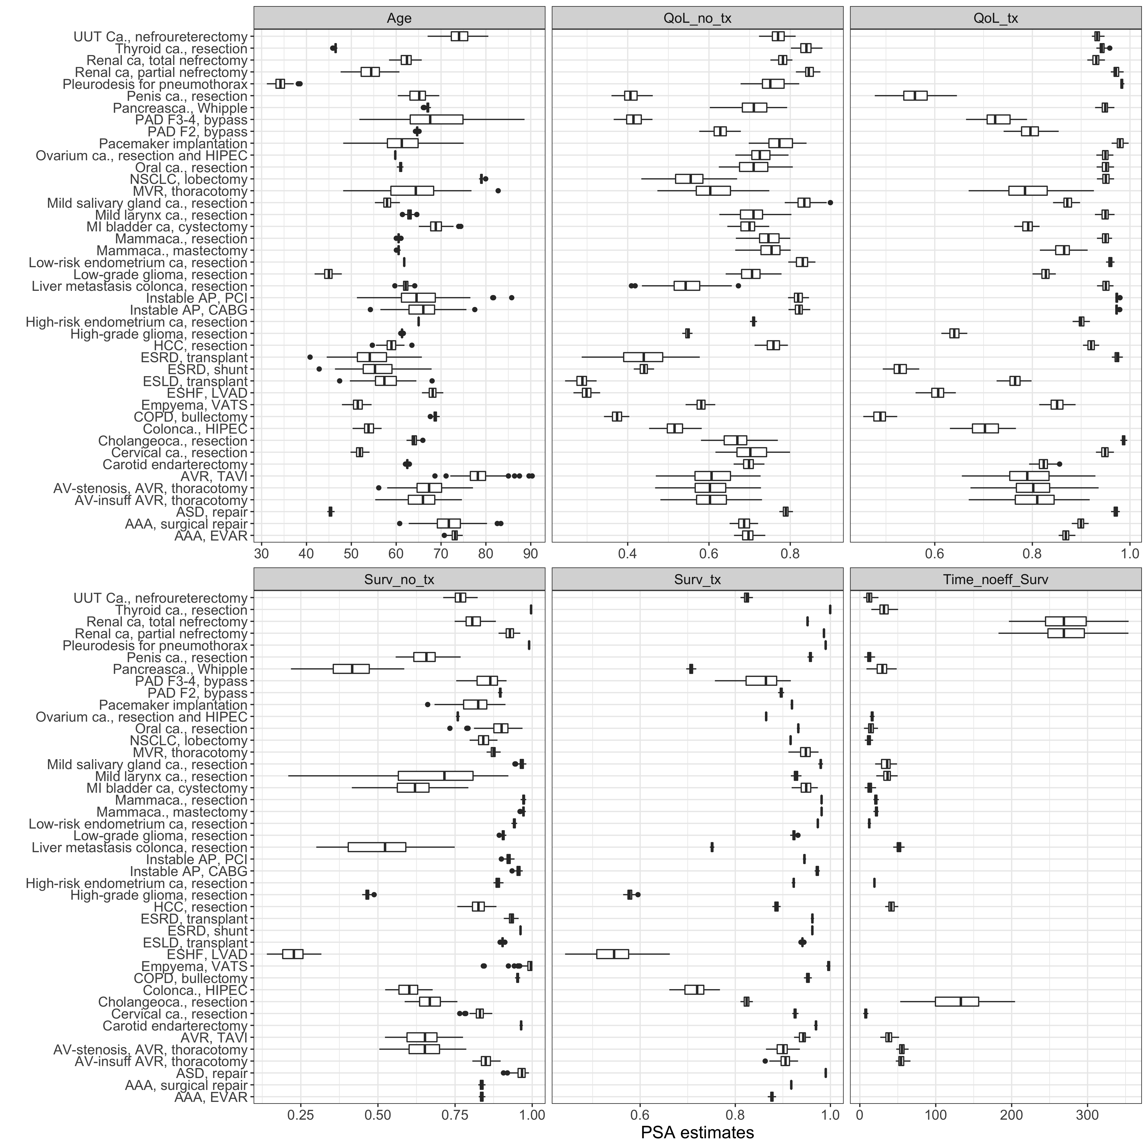
Input

Slide 18
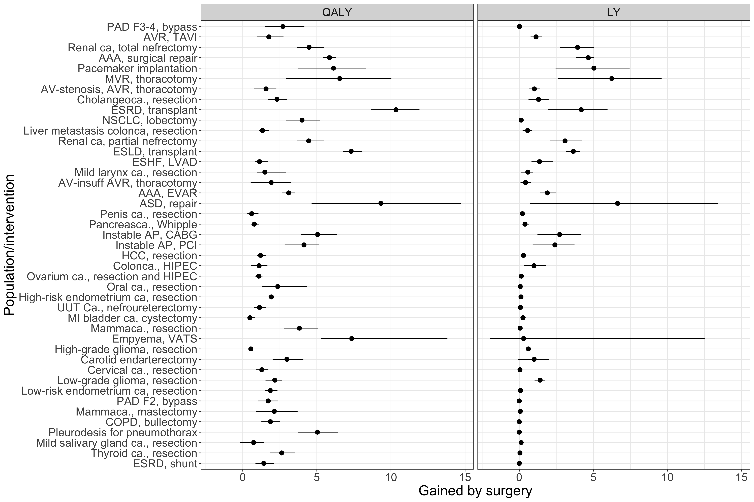
Output Associated QALYs
Benjamin – I removed LY form the figure – but using crop you can easly add it back if you like to have both QALYs en LY in the presentation this time

Slide 19
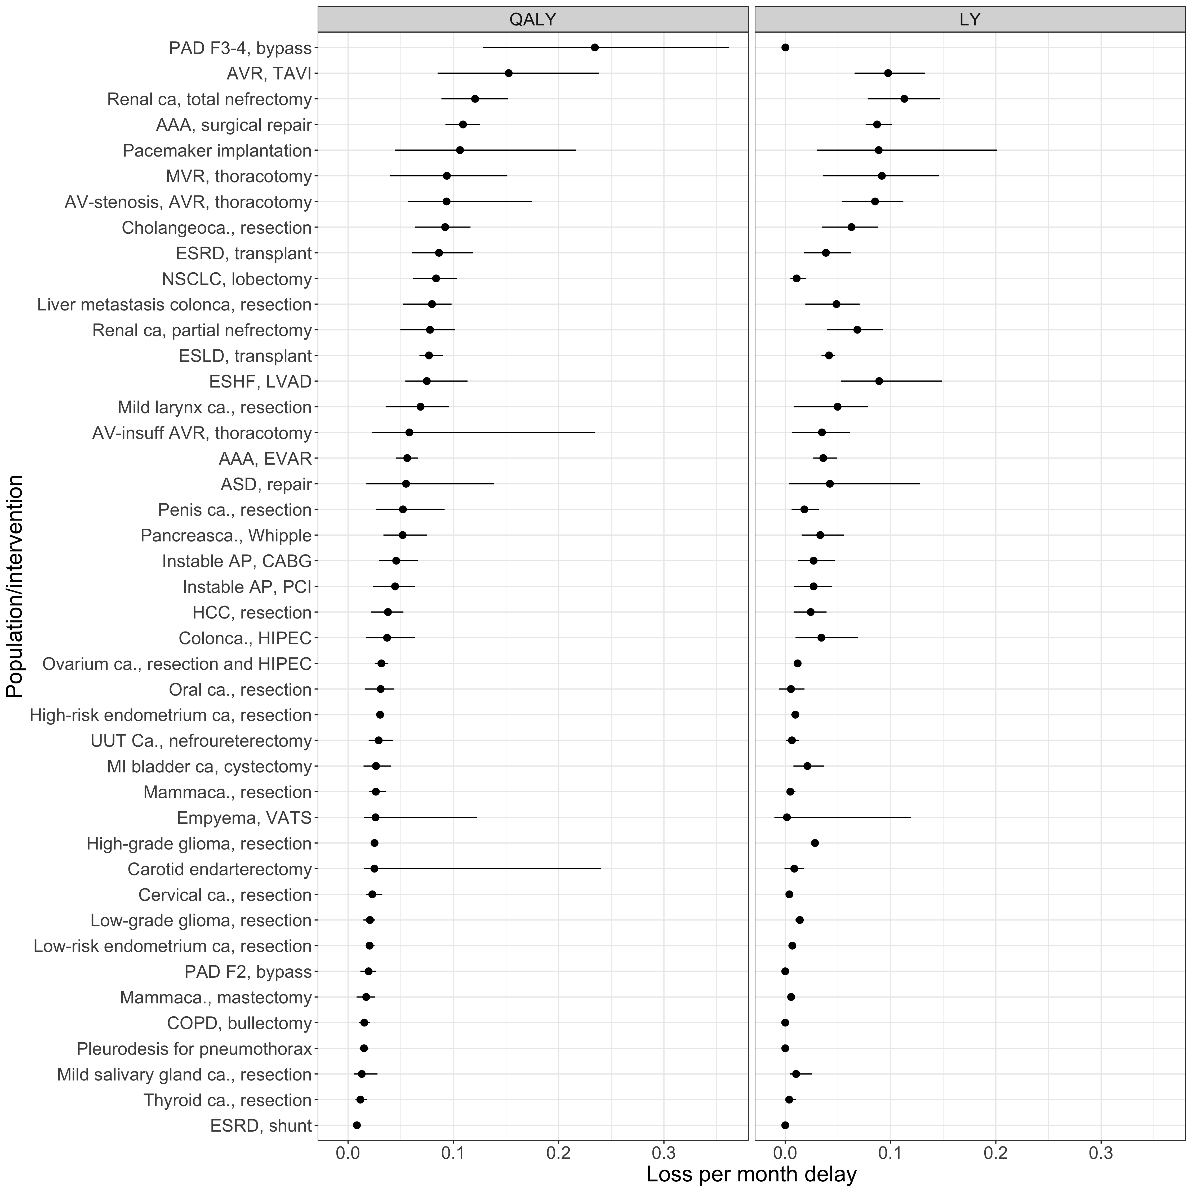
Output Urgency

Slide 20
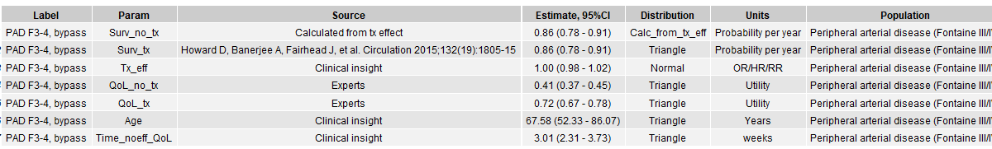
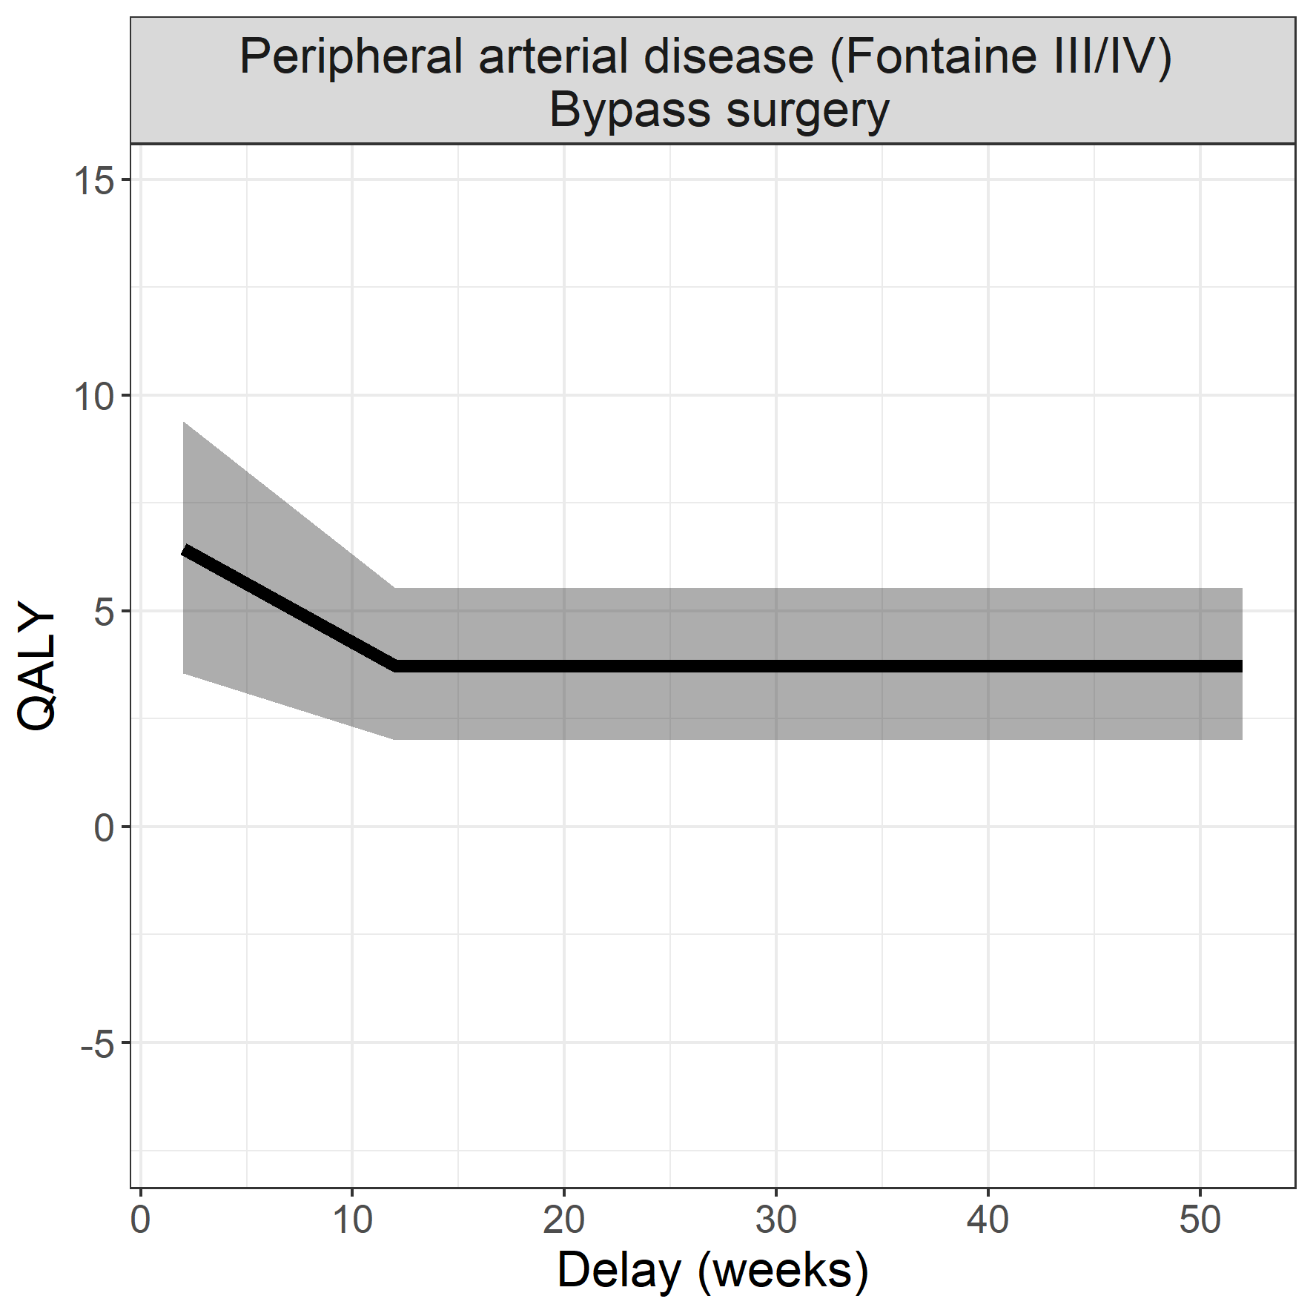
Output Urgency
NIEUWSTE MEEST URGENTE AANDOENING

Slide 21
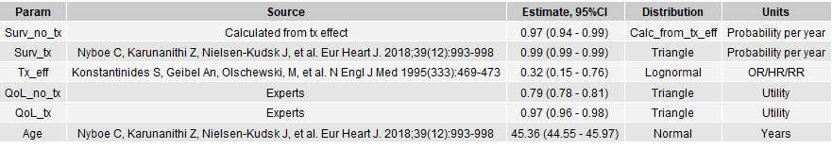
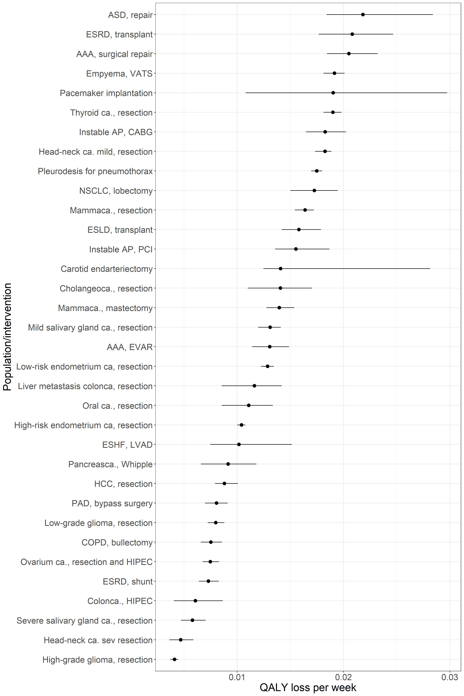
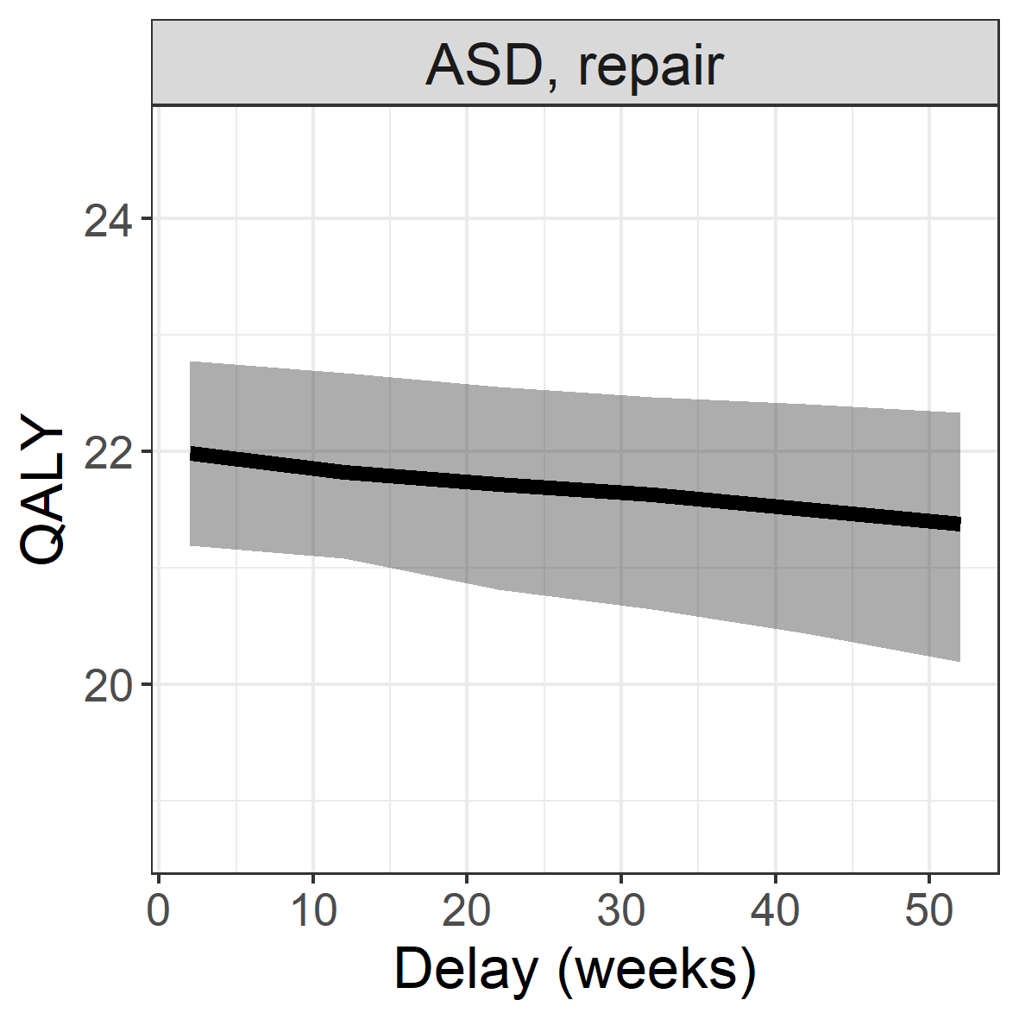
Output Urgency
KAN ER DAN UIT

Slide 22
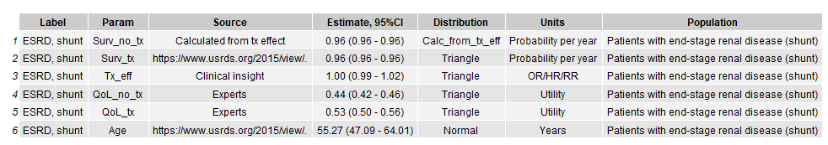
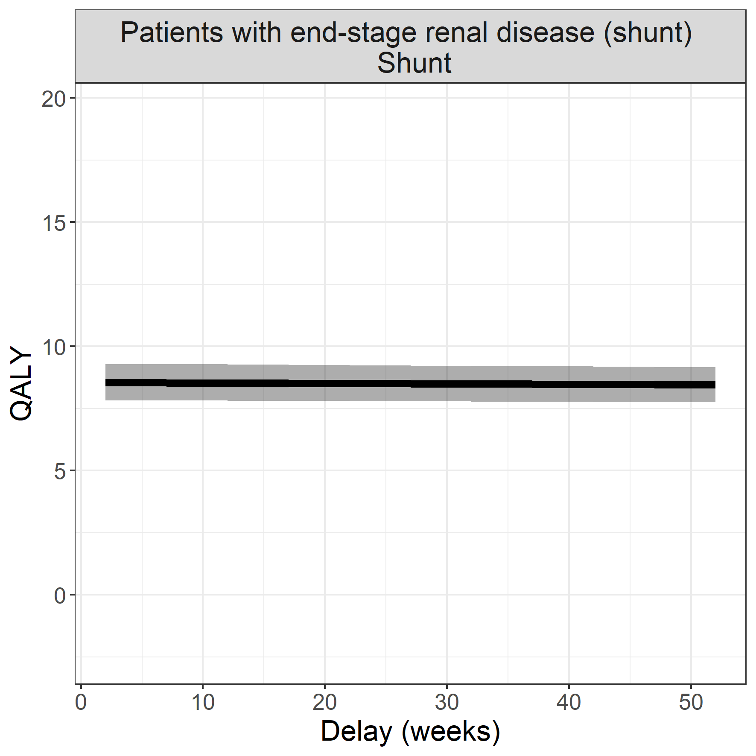
Output Urgency

Slide 23
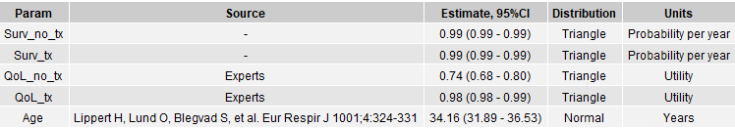
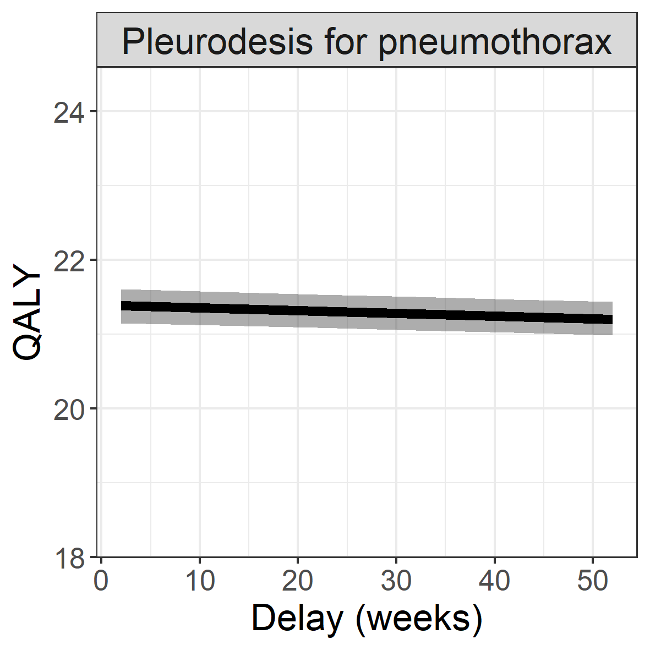
Output Urgency
Ik denk dat we slechts 2 moeten presenteren ivp drie zoals eerder. Maakt de presentative iets korter

Slide 24
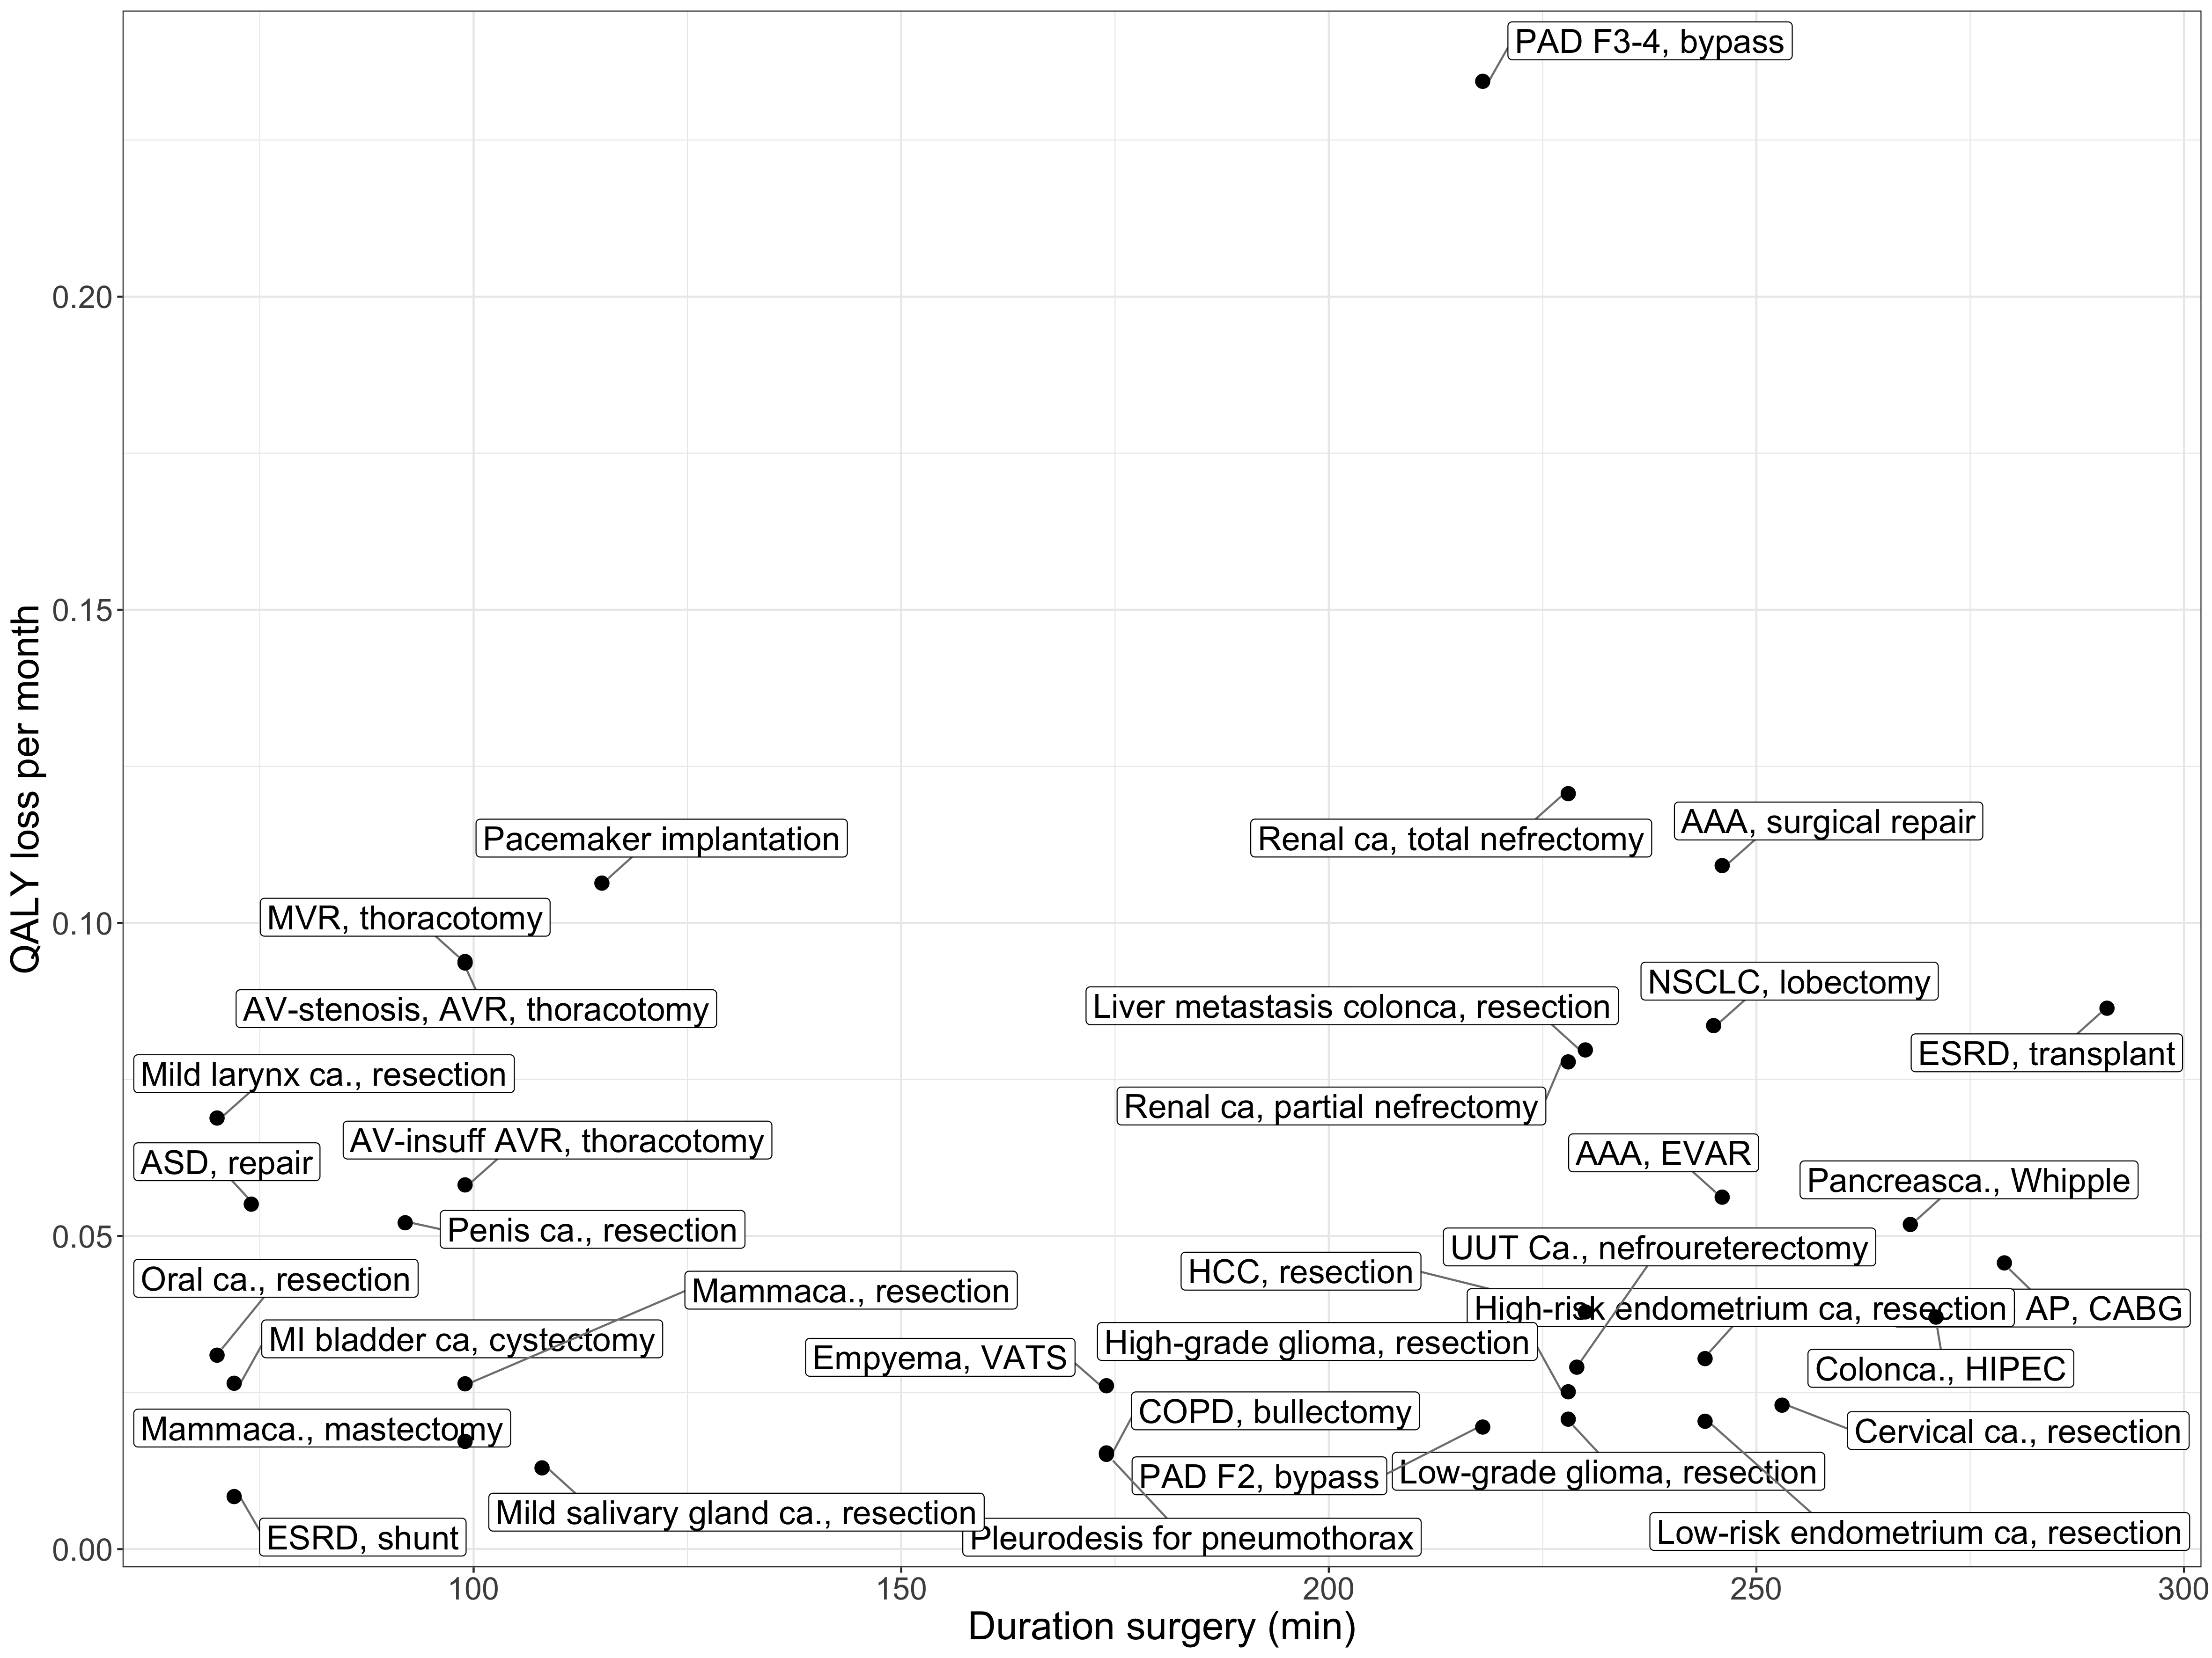
Link with HIX data

Slide 25
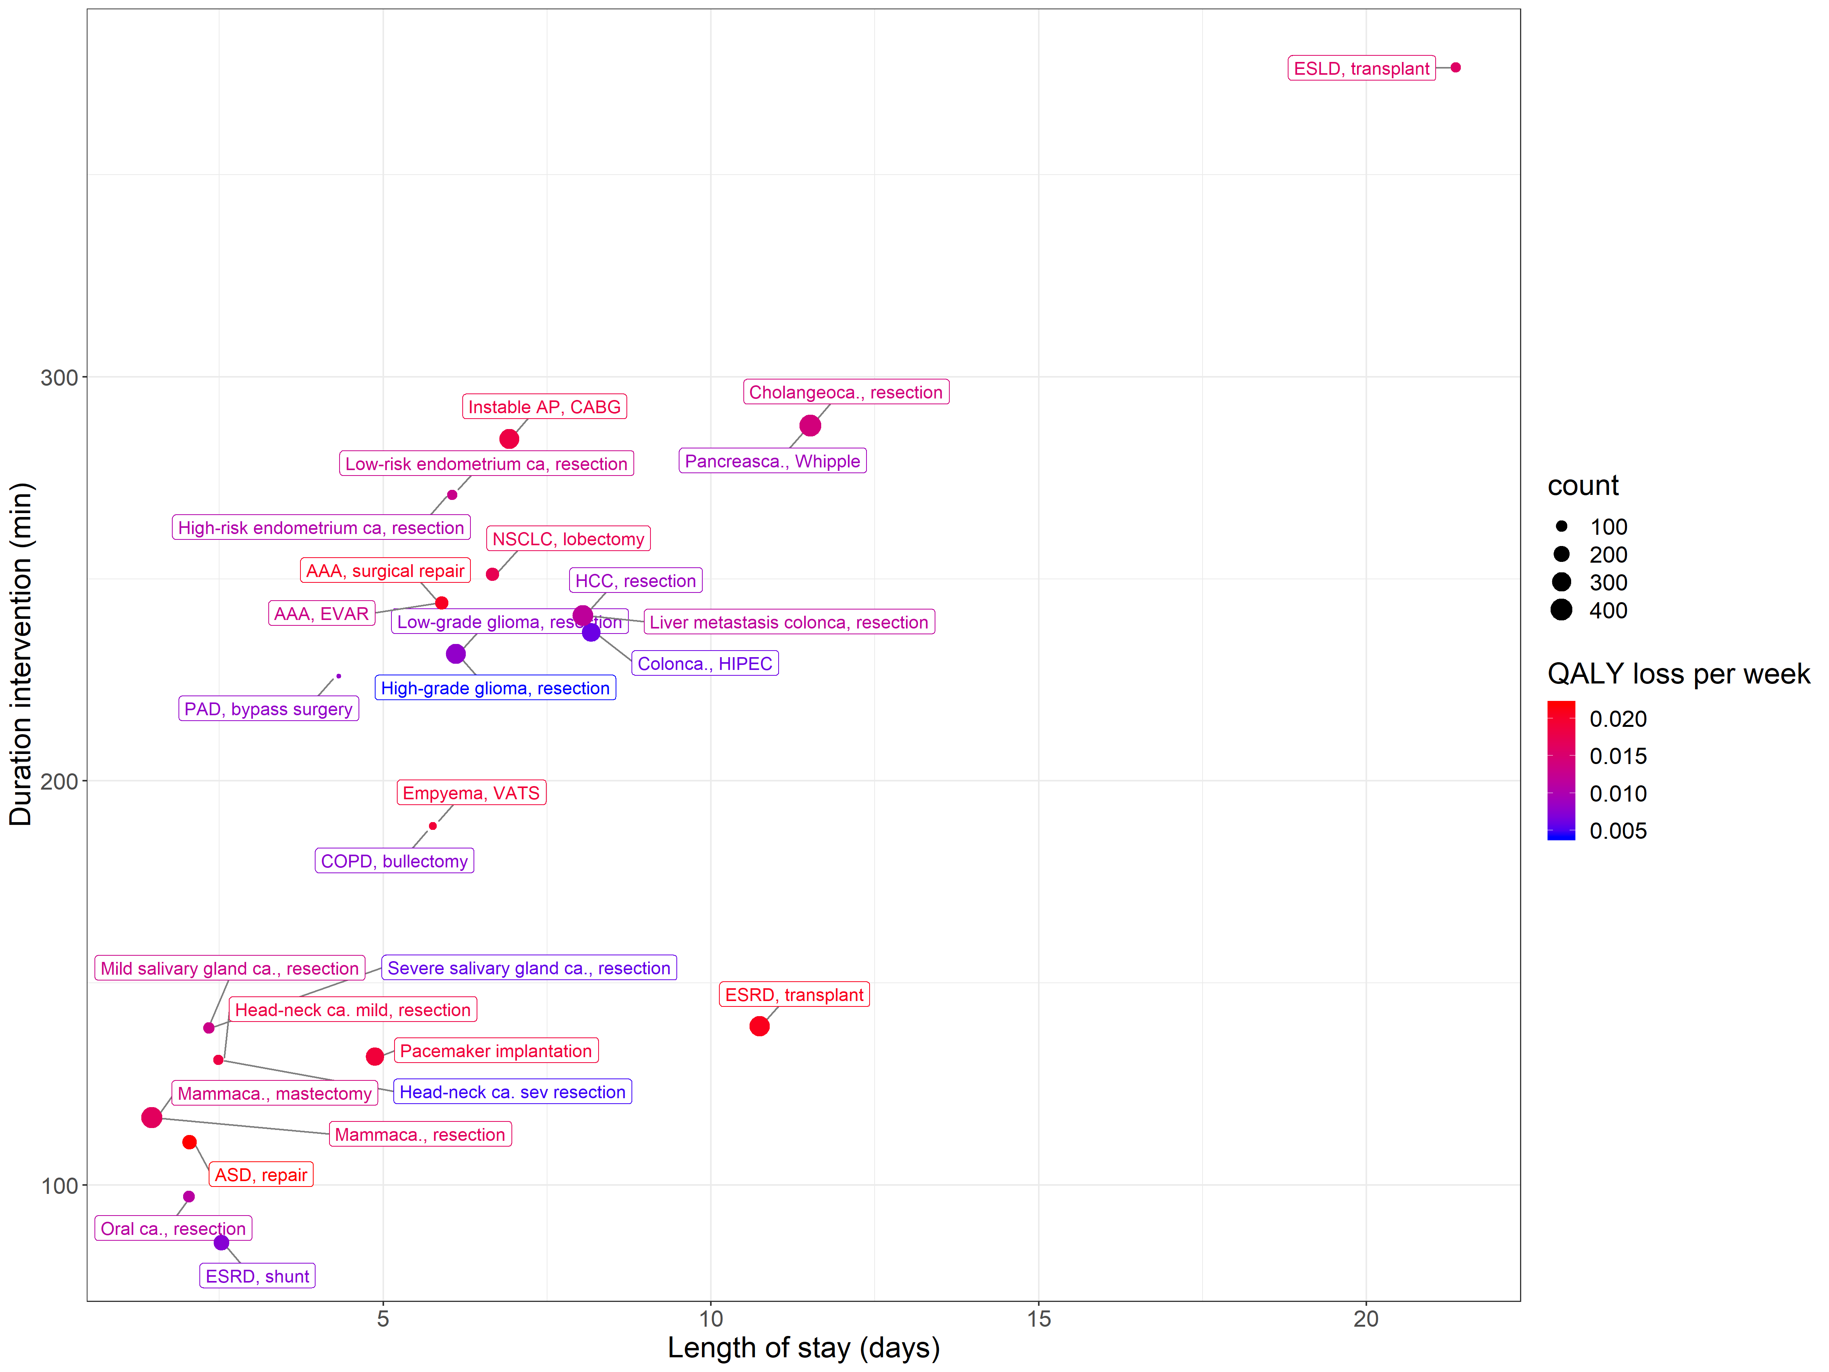
Link with HIX data
I suggeste we delete

Slide 26
Caveats
Model results are for the "average" patient: a clinical expert opinion is important for extrapolation for individuals
Comorbidities are not taken into account
Disutility's for recovery from surgery is not taken into account (as we assume this is similar regardless the time of delay)
Assumptions:
All surgeries are successful
COVID-19 situation does not affect the quality of care in the Erasmus MC
COVID-19 situation does not change the parameter values (QoL and survival of patients)
Because of these assumptions, operations in our model can only benefit patients. Therefore the absolute QALYs associated with operations are too optimistic.
Notes:
Many more assumptions are in the report, but we think that these are the most important once.

Slide 27
This approach only work if all stakeholders believe in this idea
Stakeholders:
Doctors
Patients
Decision makers

Slide 28
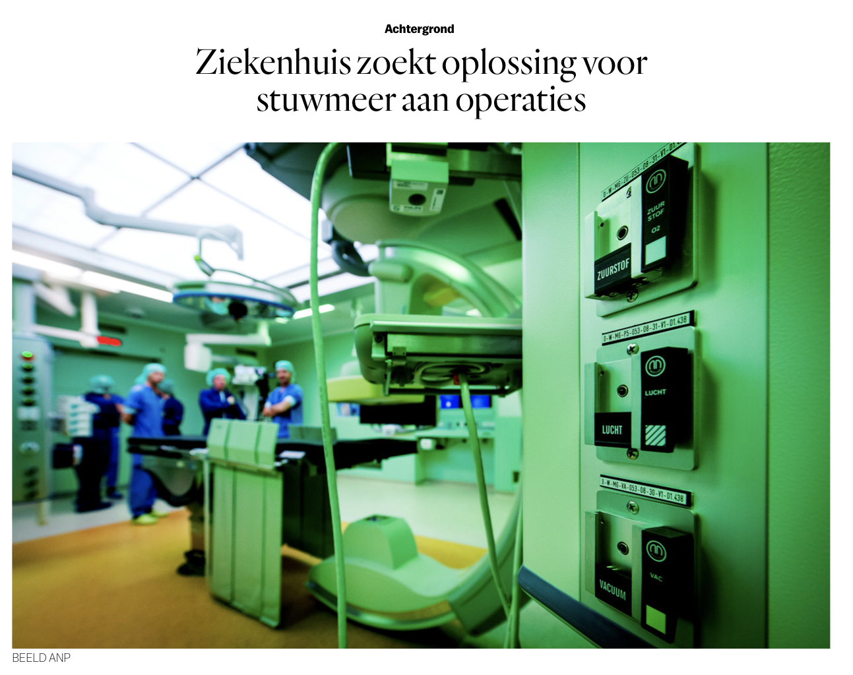
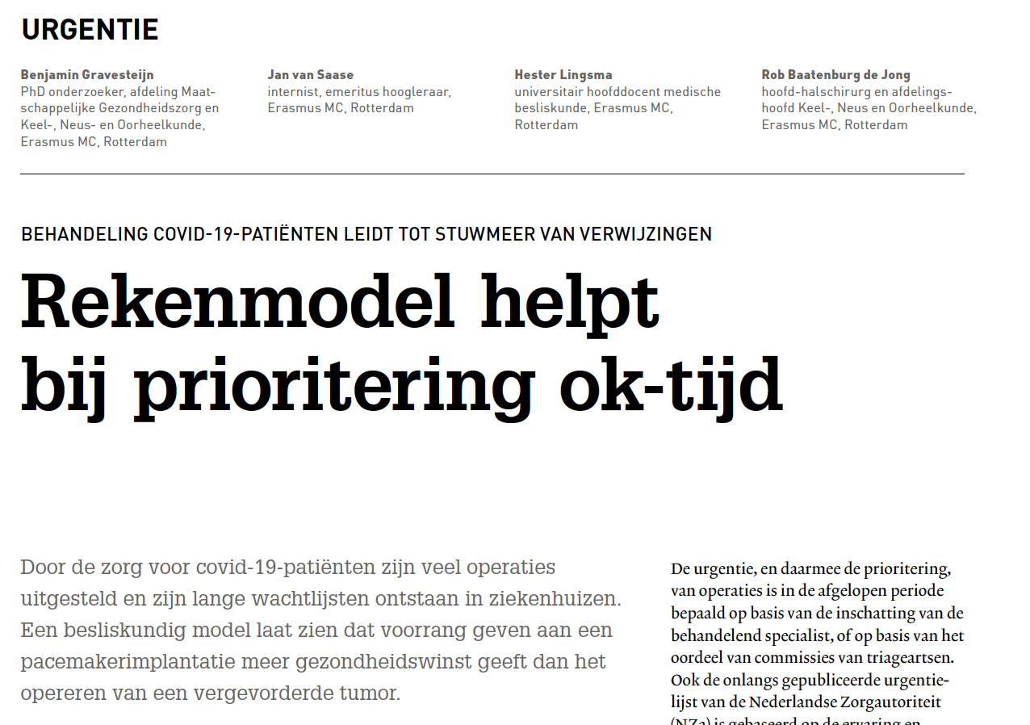

Media

Slide 29
Our view about “the real world” was to naïve
Decision making theory is nice in theory, but not used the way ”decision scientists” think
Cost-effectiveness has not been proven for many already implemented interventions.
For some doctor: decision models” are still rocket science
Clear communication about what a decision model can and also what it can NOT is important

Slide 30

Notes:
https://www.ggztotaal.nl/nw-29166-7-3686461/nieuws/ggz_nederland_er_wordt_hard_gewerkt_om_wachtlijsten_weg_te_werken.html

Slide 31
Acknowledgment
R.J. Baatenburg de Jong
H.F. Lingsma
I.R.A. Retel Helmrich
E. van Veen
C.L. van Lint
S.M. Bruinsma
J.J. van Busschbach.
We would like to acknowledge C. Verhoef, C.H. Bangma, C.M.F. Dirven, E.M. Roes, G. Geleijnse, G. Jansen van Rosendaal, H.A. Polinder - Bos, J.A. Goudzwaard, J.J.M. Takkenberg, J.L.C.M. van Saase, M.G. van Vledder, P.J.E. Bindels, S. Sleijfer, T.W. Galema for their participation in QoL rating.
A special thanks goes to H. Karreman and C. Van der Velden - van der Graaf

Slide 32

Our decision model can be used as a tool to prioritize semi-elective surgery by minimizing QALY loss due to delays

